Slide 1
How to create a R markdown for homework

Slide 2
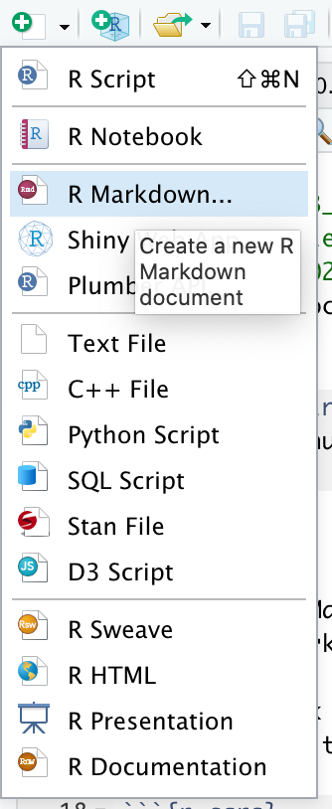
1. Click the “new” button at the left upper corner, choose “R Markdown”

Slide 3
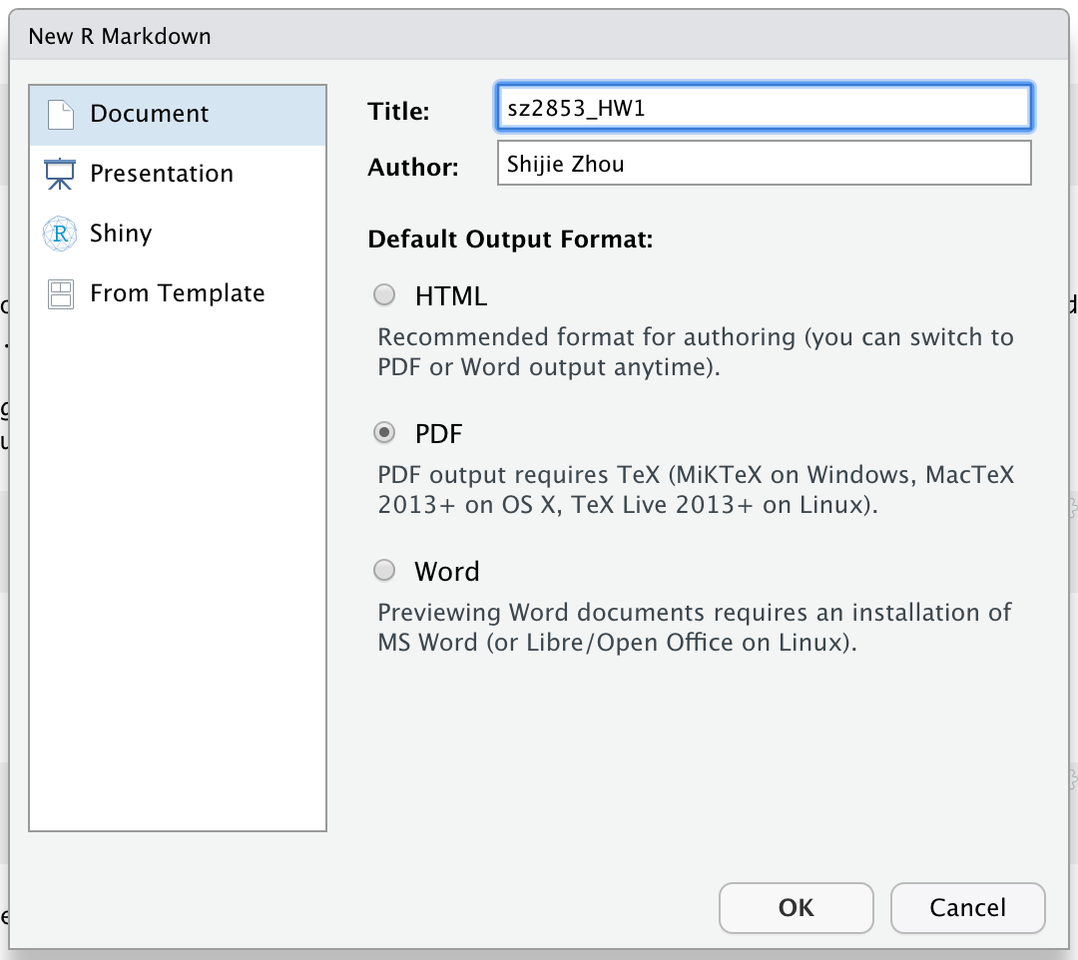
2. The “Title” should be: YourUNI_HW1(,2,3…)
The “Author” should be: Your full name
Choose the “Default Output Format” as “PDF”

Slide 4
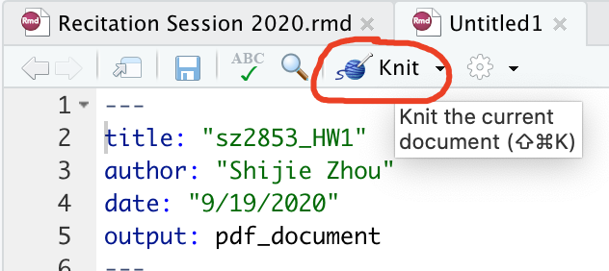
3. Click “Knit”, name your file the same as your title

Slide 5
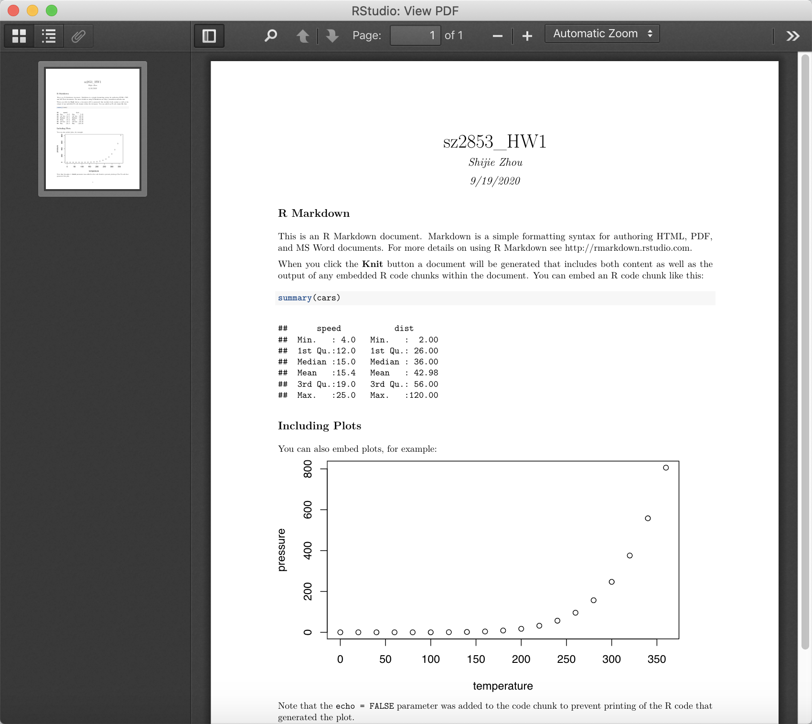
4. Then you will get the pdf file

